Slide 1
Internet Of the Things
Juan Manuel Servera
@jmservera
juanserv@microsoft.com

Slide 2
The Internet of the Your Things
Juan Manuel Servera
@jmservera
juanserv@microsoft.com

Slide 3
What is the Internet of (your) Things?
Things
Connectivity
Data
Analytics

Slide 4
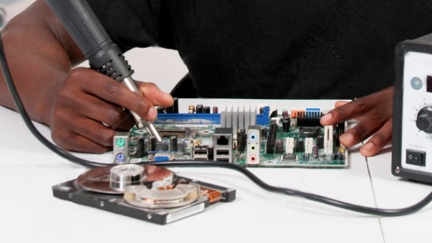

Slide 5
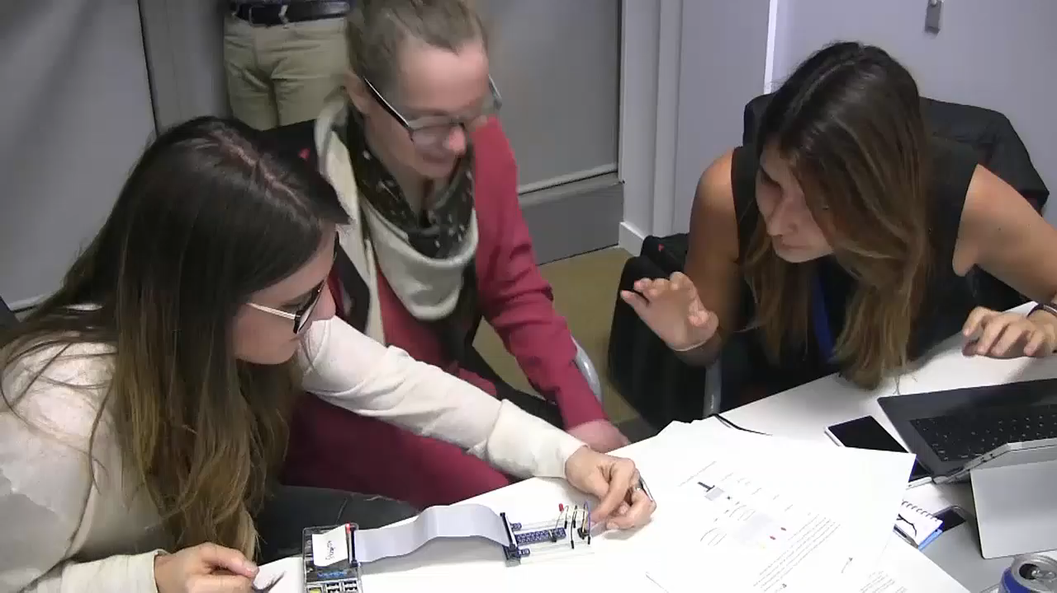

Slide 6










Microsoft Azure services for IoT
Producers | Data Transport | Storage | Analytics | Presentation & action
 | IoT Hub /Event Hubs (Service Bus) | SQL Database | Machine Learning | Azure Websites
 | Heterogeneous client agents | Table/Blob Storage | HD Insight | Mobile Services
 | External Data Sources | DocumentDB | Stream Analytics | Notification Hubs
 |  | External Data Sources | Cloud Services | Power BI
 |  |  |  | External Services
{ }

Slide 7
Every-Things
Old and new
Heterogeneous platforms
Microcontrollers
OS powered devices
Directly connected & Gateway connected
Allow Cloud IoT solutions to interoperate

Slide 8
Babel-Things
Programming languages
C, Java, JavaScript, Python, C#, …
Communication protocols
HTTP/REST, MQTT, AMQP, CoAP, XMPP, CAN, ModBus, BACNet, …

Slide 9
Secure-Things
Privacy
Access control
Authentication
Encryption

Slide 10
What can you do with a device connected to Azure IoT?

Slide 11
Azure IoT Hub features
Telemetry
Send high throughput telemetry data
Device Twin
Synchronize configuration properties between Cloud and device
Methods
Imagine calling a method on a device from the Cloud… and vice-versa
Device Management (Public Preview)
Enroll, organize, maintain, decommission devices

Slide 12
Connect Devices to Azure IoT

Slide 13


Custom Cloud Gateway
(Cloud Service, VM)
Management app
Device registry/Management
Monitoring
Send commands
Device
Custom Protocols
Applications
Companion apps
Dashboards
Controllers
…
Cloud protocol gateway sample
IoT Hub service Client SDK
Device
AMQP, MQTT, HTTPS
IoT Hub
IoT Hub device Client SDK
Device
Field Gateway
CoAP, AllJoyn, OPC,…
Device
AMQP, MQTT, HTTPS
IoT Hub device Client SDK
Device
Field Gateway
Custom Cloud Gateway
(Cloud Service, VM)
Cloud protocol gateway sample
Management app
Device registry/Management
Monitoring
Send commands
OPC, HTTP, CoAP,…
CoAP, AllJoyn, OPC, …
Device
VPN/ExpressRoute
Custom code
IoT Hub service Client SDK
Azure IoT open source code

Slide 14
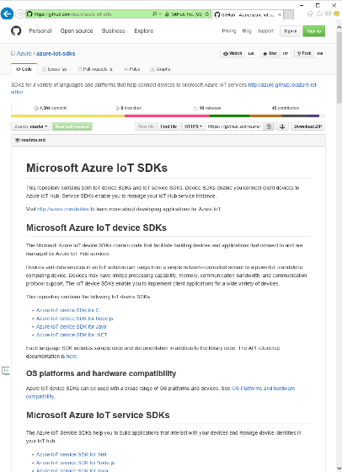
Azure IoT SDKs
Open Source
Everything is on GitHub, open source under MIT license
Cross-Platform Support
Microcontrollers (ARM Mbed, Arduino, ESP8622, TI CC3200,…)
RTOS, Linux (Ubuntu, Debian, Fedora, Raspbian), Windows 7/8/10, Android, iOS (with Xamarin)
Multi-Language Support
Service Client SDK – C#, Java, JavaScript, Python (on its way)
Device Client SDK – C, JavaScript, Java, C# (including PCL), Python
Xamarin Compatible
Includes Xamarin compatible libraries
Packages
NuGet, npm, maven, apt-get
Tools
X-plat CLI (iothub-explorer) and for Windows (Device-Explorer)
Easy To Get Started
Samples, walkthroughs to get you started quickly

Slide 15
Device & Service Client SDKs
Client | OS/Runtime | Version | Protocols | Packages
C device client | Debian Linux | 7.5 | HTTPS, AMQP, MQTT, AMQP over WebSockets | None
 | Fedora Linux | 20 | HTTPS, AMQP, MQTT, AMQP over WebSockets | None
 | mbed OS | 2 | HTTPS, AMQP, MQTT | https://developer.mbed.org/users/AzureIoTClient/
 | TI-RTOS | 2.x | HTTPS | None
 | Ubuntu Linux | 14.04 | HTTPS, AMQP, MQTT, AMQP over WebSockets | https://launchpad.net/~aziotsdklinux/+archive/ubuntu/ppa-azureiot
 | Windows desktop | 10 | HTTPS, AMQP, MQTT, AMQP over WebSockets | https://www.nuget.org/packages/Microsoft.Azure.IoTHub.IoTHubClient/
 | Yocto Linux | 2.1 | HTTPS, AMQP | None
 | Arduino (MKR1000, Zero, ESP8266, Feather M0) | IDE 1.6.8 | HTTPS | https://github.com/arduino-libraries/AzureIoTHub
Node.js Device client | Node.js | 0.10+ | HTTPS, AMQP, MQTT, AMQP over WebSockets | https://www.npmjs.com/package/azure-iot-device
Node.js Service client | Node.js | 0.10+ | N/A | https://www.npmjs.com/package/azure-iothub
Java Device client | Java SE (Windows) | 1.7 | HTTPS, AMQP, MQTT | http://mvnrepository.com/artifact/com.microsoft.azure.iothub-java-client/iothub-java-device-client
 | Java SE (Linux) | 1.7 | HTTPS, AMQP, MQTT | http://mvnrepository.com/artifact/com.microsoft.azure.iothub-java-client/iothub-java-device-client
 | Android | API 15 | HTTPS, MQTT
Java Service client | Java SE | 1.8 | N/A | http://mvnrepository.com/artifact/com.microsoft.azure.iothub-java-client/iothub-java-service-client
C# Device client | .Net | 4.5 | HTTPS, AMQP, MQTT, AMQP over WebSockets | https://www.nuget.org/packages/Microsoft.Azure.Devices.Client/
 | UWP | 10 | HTTPS, AMQP | https://www.nuget.org/packages/Microsoft.Azure.Devices.Client/
 | PCL (Xamarin, Mono, UWP, WP8.1, Win8.1) |  | HTTPS, AMQP, MQTT, AMQP over WebSockets | https://www.nuget.org/packages/Microsoft.Azure.Devices.Client.PCL/
C# Service client | .Net | 4.5 | N/A | https://www.nuget.org/packages/Microsoft.Azure.Devices/
Python Device client | Python | 2.7.x, 3.4.x, 3.5.x | HTTPS, AMQP, MQTT | none

Slide 16
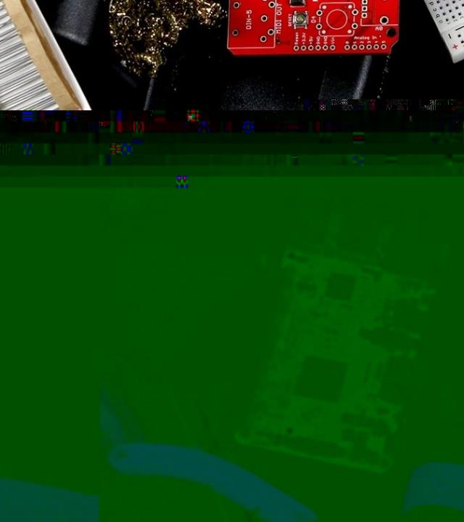
Hardware requirements
… It depends…
Bare minimum you’ll need on the device:
Being capable of establishing an IP connection
Support TLS
Have a Real Time Clock or implement code to connect to an NTP server
Having at least 64KB of RAM

Slide 17
Azure IoT Gateway SDK
Open source IoT gateway middleware that enables:
Cloud connectivity for devices that don't speak TCP/IP
Security Isolation for devices that can't be updated/secured
Protocol translation for existing and new protocols
Data transformation compression, annotation, filtering
Local intelligence and local processing for low latency needs
Gateway hardware
Module
Module
Module
Internet ready
Protocol (e.g. MQTT)
Telemetry
Protocol A
Telemetry
Protocol A
Ingestion
Filter
Send to cloud
Operating System (Windows, Wind River, Ubuntu, etc.)

Slide 18
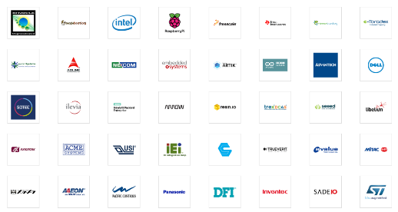

Azure Certified for IoT
Certified to Work Great with Azure IoT
Heterogeneous operating systems & devices
Over 70 Partners & Growing
Over 110 Devices Certified
Azure IoT Device SDK Supports Even More!
Azure IoT Device SDK supports more than Azure Certified for IoT and is easy to adapt to new devices and operating systems

Slide 19
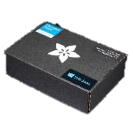
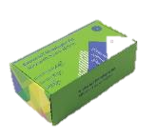
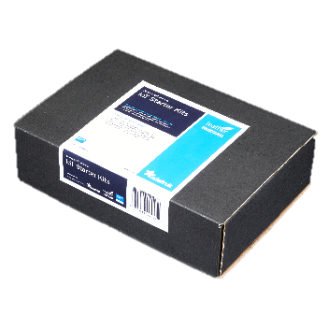
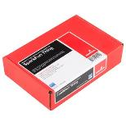
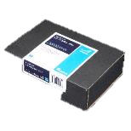
Azure IoT Starter Kits
Raspberry Pi 2 Kit
Windows 10 and Raspbian
Samples in C and C#
Intel Edison Kit
Linux Yocto
Samples in JavaScript (Node.js)
Feather M0 Wi-Fi Kit
RTOS
Samples in Arduino IDE and C
ThingDev Kit
RTOS
Samples in Arduino and C
Feather Huzzah ESP8266 Kit
RTOS
Samples in Arduino IDE and C
http://azure.com/iotstarterkits

Slide 20
Resources
Azure IoT Client SDKs: github.com/azure/azure-iot-sdks
Get started with Azure IoT Hub device management: azure.microsoft.com/en-us/documentation/articles/iot-hub-device-management-get-started/
Azure IoT Gateway SDK repo: github.com/Azure/azure-iot-gateway-sdk
Microsoft Azure IoT reference architecture: azure.microsoft.com/en-us/updates/microsoft-azure-iot-reference-architecture-available/
Azure IoT Partner Portal: aka.ms/AzureIoTPartner
Certified for Azure IoT: www.azure.com/certifiedforiot
Azure IoT User Voice forum: feedback.azure.com/forums/321918-azure-iot

Slide 21
Where do I Start?
http://windowsondevices.com
http://connectthedots.io
http://microsoft.hackster.io
http://thinglabs.io

Slide 22
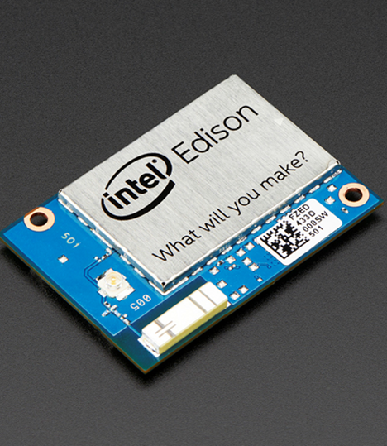
Intel® Edison Module
Small, Powerful & Adaptable Hardware
Dual-core Intel® Atom™ processor 500MHz
Integrated Wi-Fi*, Bluetooth® Low-Energy (LE)
32-bit Intel® Quark™ microcontroller at 100 MHz
1 GB of RAM, 4 GB of Storage
40 multiplexed GPIO interfaces with expansion board options for total project design and flexibility
Yocto Project* Linux*

Slide 23
Thanks

